Slide 1



FINAL PROTOTYPE & IMPLEMENTATION
Image Thumbnail Generator
A serverless, cloud-native pipeline that turns any uploaded image into an optimized thumbnail — automatically.
TEAM TECHFUSION
Chitvan Goel
Sujal Bansal
TECHNOLOGY HIGHLIGHTS
Amazon S3
AWS Lambda
Python / Pillow
PHP
Notes:
Good [morning/afternoon] everyone. We're Team TechFusion — I'm Chitvan, and this is Sujal. Today we're presenting the final prototype of our project: an Image Thumbnail Generator. This is not a concept anymore — it's a fully working, deployed system built on AWS serverless technology, and we're excited to walk you through exactly how it works.

Slide 2


THE CHALLENGE
Why Automatic Thumbnails Matter
PROBLEM
NEED
Image-heavy applications need multiple image sizes for efficient display
A scalable, automated solution that generates thumbnails without burdening the application server.
Large original images consume excess storage and bandwidth
Offload processing to the cloud
Manually creating thumbnails is repetitive and inefficient
Scale automatically with demand
Keep storage and bandwidth costs low
Image processing adds workload to the main application server
Preserve original image quality
Problem Statement
TechFusion | 02
Notes:
Every modern web application that deals with images faces the same challenge — you need multiple sizes of the same image for galleries, previews, and listings. Storing and serving full-resolution images everywhere wastes storage and bandwidth, and generating thumbnails manually or on the main server adds unnecessary load. What's really needed is a solution that automates this process and scales on its own — which is exactly the gap we set out to fill.

Slide 3




OUR APPROACH
An Automated, Cloud-Based Thumbnail Pipeline
The user uploads an image once — the cloud handles validation, storage, processing, and delivery automatically.
1
2
3
4
5
6
User uploads
an image
Stored securely
in Amazon S3
S3 event
triggers Lambda
Lambda + Pillow
process image
Thumbnail saved
back to S3
User views original
+ thumbnail
Result: thumbnails are generated automatically within seconds of upload, with zero manual intervention and no added load on the web server.
Proposed Solution
TechFusion | 03
Notes:
Our solution is an automated, cloud-based Image Thumbnail Generator. The flow is simple from the user's perspective: they upload an image through our web interface, and everything else happens behind the scenes. The image goes to Amazon S3, that upload event automatically triggers an AWS Lambda function, Lambda uses Python and Pillow to resize the image, and the resulting thumbnail is written back to S3. The web app then retrieves both the original and the thumbnail using secure, time-limited presigned URLs. No manual steps, no server bottleneck.

Slide 4
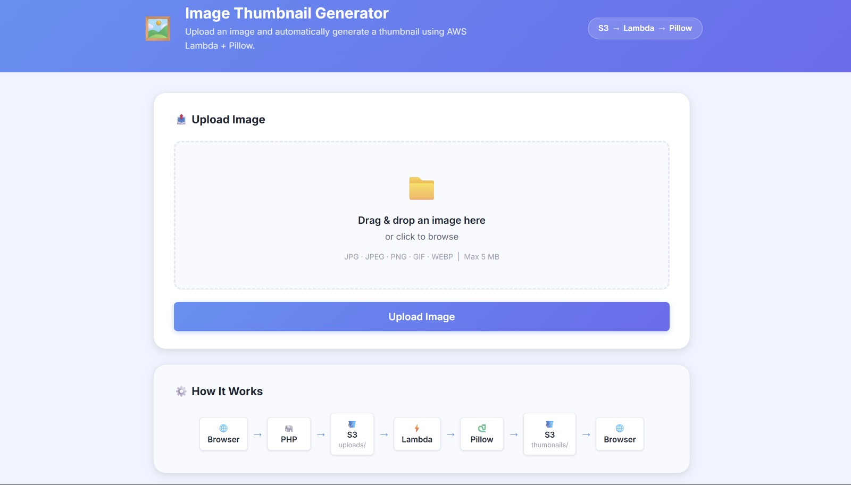
WORKING PROTOTYPE
Final Prototype — User Interface
LIVE & FUNCTIONAL
IMPLEMENTED FEATURES
Drag-and-drop upload + browse/select
Instant image preview before upload
File name & size display
Supported: JPG, JPEG, PNG, GIF, WEBP (max 5 MB)
Upload button with loading state
Real-time upload & processing status
Side-by-side original vs. thumbnail preview
Final Prototype — UI
TechFusion | 04
Notes:
This is the actual working prototype — not a mockup. On the left you can see the real interface: users can drag and drop an image or browse for one, see an instant preview along with the file name and size, and upload it with a single click. The interface enforces our supported formats — JPG, PNG, GIF, WEBP — and a 5 MB size limit. Once uploaded, the app shows live status updates and finally displays the original image next to the automatically generated thumbnail. Everything you see here is fully functional today.

Slide 5


CLOUD ARCHITECTURE
How the System Is Wired Together
Browser
Python + Pillow
User interacts with the web UI
Resizes & converts image
PHP Web App
S3 — thumbnails/
Validates & handles upload
Thumbnail stored
S3 — uploads/
check_thumbnail.php
Original image stored
Polls for completion
ObjectCreated Event
Presigned URL
Auto-triggers processing
Secure, time-limited link
AWS Lambda
Browser Displays Result
Serverless compute invoked
Original + thumbnail shown
System Architecture
TechFusion | 05
Notes:
Here's the full architecture end to end. The browser talks to our PHP web application, which validates and uploads the image into an S3 bucket under the uploads prefix. That upload automatically fires an S3 ObjectCreated event, which invokes our AWS Lambda function. Lambda runs Python with the Pillow library to resize the image and writes the thumbnail into a separate thumbnails prefix in S3. Our PHP script polls for that thumbnail, generates a secure presigned URL once it's ready, and the browser displays both images. Every arrow here represents a real, working connection in our deployed system.

Slide 6
DATA FLOW
End-to-End Working — Step by Step
1
User selects or drags an image into the browser
8
Pillow opens and processes the image
2
Client-side JavaScript validates file type & size
9
Image is resized, preserving aspect ratio
3
PHP validates the uploaded file server-side
10
Thumbnail is converted to optimized JPEG
4
A unique filename is generated
11
Lambda uploads the thumbnail to S3 thumbnails/
5
PHP uploads the original image to S3 uploads/
12
Frontend polls to check if thumbnail exists
6
S3 automatically triggers the Lambda function
13
PHP generates a time-limited presigned URL
7
Lambda downloads the image from S3
14
Browser displays original + generated thumbnail
Client / Upload
Lambda Processing
Delivery
TechFusion | 06
Notes:
This slide breaks the entire pipeline into fourteen concrete steps. It starts on the client side — image selection, JavaScript validation — moves through PHP server-side validation and the S3 upload, and then the blue-to-navy transition shows exactly where Lambda takes over: downloading the image, processing it with Pillow while preserving aspect ratio, and writing back an optimized JPEG. The final steps in green cover delivery — polling, presigned URL generation, and displaying the result. Every one of these steps runs in our deployed prototype today.

Slide 7

UNDER THE HOOD
Technical Implementation
Frontend
Backend
AWS Lambda
Vanilla JavaScript
PHP 8
Python 3.12
Drag-and-drop functionality
AWS SDK for PHP
Pillow (PIL) image library
Client-side validation
S3 upload handling
Automatic image processing
Live image preview
Server-side MIME validation (finfo)
Aspect-ratio-preserving resize
AJAX / fetch-based upload
Unique random filenames
JPEG thumbnail generation
Status updates
Presigned URL generation
Polling for thumbnail completion
Handles multiple image modes — RGB, RGBA, and palette-based images — and processes the first frame of animated GIFs.
Technical Implementation
TechFusion | 07
Notes:
On the frontend, we built everything in vanilla JavaScript — no frameworks — handling drag-and-drop, client-side validation, live previews, and asynchronous polling. On the backend, PHP 8 with the AWS SDK handles the upload, performs real MIME-type validation using finfo rather than trusting file extensions, and generates presigned URLs. The actual image processing lives in AWS Lambda, written in Python 3.12 using Pillow — it resizes images while preserving aspect ratio and outputs an optimized JPEG. We also made sure the system correctly handles different image modes, including RGBA and palette-based images, and animated GIFs by processing their first frame.

Slide 8


ENGINEERING QUALITY
Security, Reliability & Optimization
Security
Reliability & Optimization
AWS credentials stored in .env (excluded from version control)
S3 event scoped to the uploads/ prefix only
Private S3 bucket — no public access
Prevents Lambda from re-triggering on its own output
Presigned URLs instead of public image links
Thumbnail generation runs asynchronously
Server-side MIME-type validation
Aspect ratio always preserved
File extension & file size validation
Unique randomized filenames
Images are never unnecessarily enlarged
Path traversal protection
Thumbnail output optimized as JPEG
Least-privilege IAM policies
TechFusion | 08
Notes:
Security wasn't an afterthought. Our AWS credentials are kept in environment variables and never committed to version control, the S3 bucket is fully private, and all image access happens through time-limited presigned URLs rather than public links. We validate files both by extension and by actual MIME type, randomize filenames to prevent collisions or path traversal, and follow least-privilege IAM policies for every AWS role. On the reliability side, we scoped our S3 event trigger specifically to the uploads prefix — this is an important detail, because without it, Lambda writing a thumbnail back to S3 could accidentally re-trigger itself in an infinite loop. Processing is asynchronous, and we always preserve aspect ratio and never upscale images.

Slide 9
OUTCOME
Prototype Results & Improvements
Original Upload
Processing
Thumbnail Ready
Full-resolution image received
Lambda + Pillow resize in progress
Optimized JPEG delivered
Successful image upload
Automatic Lambda invocation
APPROACH COMPARISON
Aspect | Earlier / Basic Approach | Final Prototype
Processing | Manual / server-based | Automated via Lambda
Storage | Application server | Amazon S3
Image processing | Application workload | Serverless Lambda
Access | Direct / public | Presigned URLs
Validation | Basic | Client + server-side
Scaling | Limited | Cloud-based, elastic
Results & Improvements
TechFusion | 09
Notes:
The results speak for themselves: uploads succeed reliably, Lambda is invoked automatically every time, and the interface is responsive and modern with clear status feedback and error handling throughout. The comparison table puts it in perspective — where a basic approach relies on manual, server-based processing with limited scaling, our final prototype offloads everything to serverless Lambda, stores files in S3, secures access with presigned URLs, and validates on both client and server. We're not claiming specific performance numbers we haven't benchmarked — but structurally, this is a fundamentally more scalable design.

Slide 10
LOOKING AHEAD
Future Scope & Conclusion
Multiple thumbnail sizes
Batch image processing
Additional image formats
Compression controls
WebP / AVIF output
CDN integration
Fully serverless deployment
Processing history
User authentication
Monitoring & analytics
Storage lifecycle policies
CONCLUSION
This project successfully demonstrates cloud-based image processing, event-driven architecture, serverless computing, secure object storage, and automated image transformation — as a complete, functional end-to-end prototype.
“From image upload to automated thumbnail generation — the entire workflow is cloud-powered, automated, and scalable.”
TechFusion
Chitvan Goel | Sujal Bansal
Notes:
Looking ahead, there's plenty of room to grow this system — generating multiple thumbnail sizes, supporting batch processing, adding formats like WebP and AVIF, integrating a CDN, and adding user authentication and monitoring are all realistic next steps. But to conclude: this project set out to solve a real, common problem, and we've delivered a genuinely working, cloud-based, event-driven, serverless solution using S3, Lambda, Python, and PHP — from upload to automated thumbnail generation, the entire workflow is live today. Thank you — we're happy to take any questions or walk through a live demo.

